Slide 1
Integrating Cybersecurity into the Next Generation Science Standards
Andrea C. Burrows Mike Borowczak
University of Wyoming Dec 2018
Andrea.Burrows@UWYO.edu |Mike.Borowczak@UWYO.edu
@SciEdBurrows | @mborowczak

Slide 2
Context: Combined Teacher/Student GenCyber
70+ K12 teacher/student participants
Common K12 pedagogical strategy: active-inquiry
Four accessible active-inquiry cybersecurity “labs”
Micro:Polo – Open Networks / Adversarial Thinking & Ethics
Micro:Bot:Wars – Command, Control, and Cryptography / CIA-Triad
Lock:Bit - Spoofing an Intelligent Lock / Keep It Simple & Online Safety
Micro:Fit:Bit – Forensics, Privacy, and Data Mining / Defense in Depth
Andrea.Burrows@UWYO.edu |Mike.Borowczak@UWYO.edu
@SciEdBurrows | @mborowczak

Slide 3
Next Generation Science Standards: DCI, CCC, SEP
Andrea.Burrows@UWYO.edu |Mike.Borowczak@UWYO.edu
@SciEdBurrows | @mborowczak

Slide 4
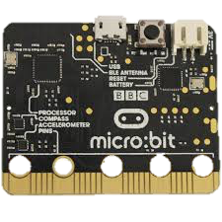
GenCyber Wyoming used a Micro:bit after the morning sessions each day
Andrea.Burrows@UWYO.edu |Mike.Borowczak@UWYO.edu
@SciEdBurrows | @mborowczak
Miniature computing device; microcontroller based processor; Bluetooth Low Energy (communication channel); compass; 3 axis (XYZ) Accelerometer; temperature sensor; light sensor; 2 button inputs; 3 capacitive touch inputs; LED matrix (5x5);
The Micro Bit is an open source hardware ARM-based embedded system designed by the BBC for use in computer education in the UK. (It was first announced on the launch of BBC's Make It Digital campaign on 12 March 2015 with the intent of delivering 1 million devices to pupils in the UK.)

Slide 5
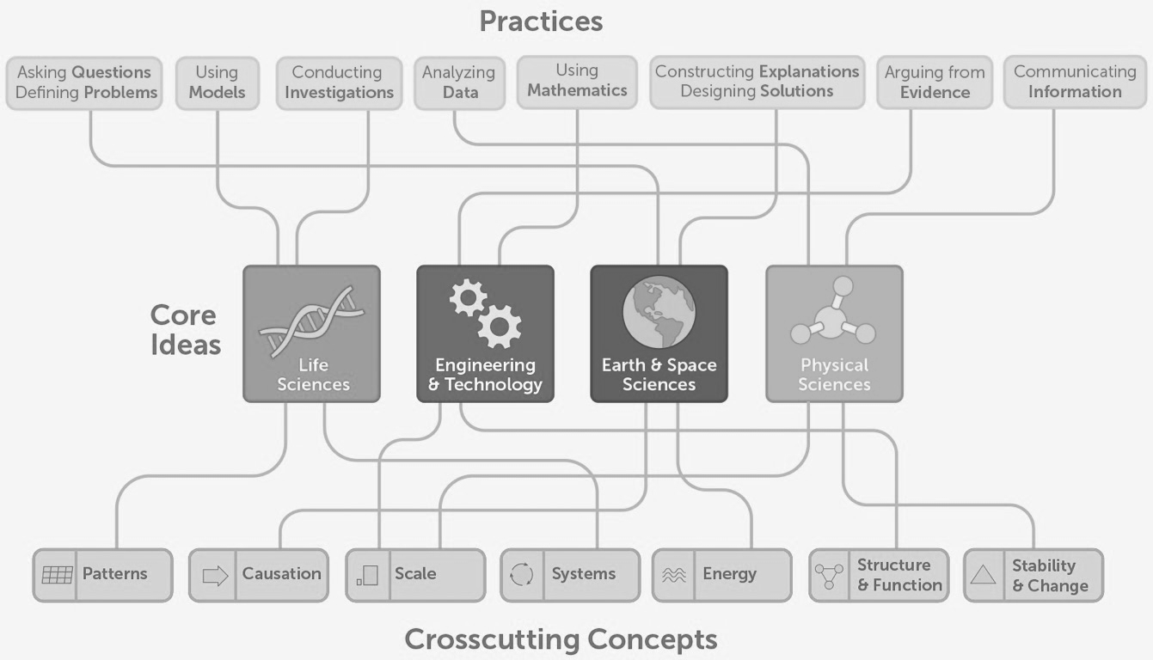
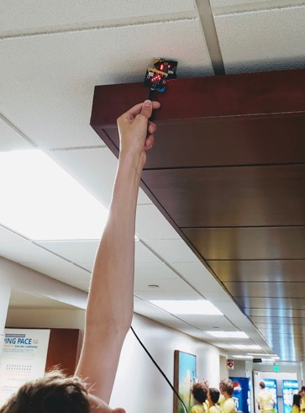
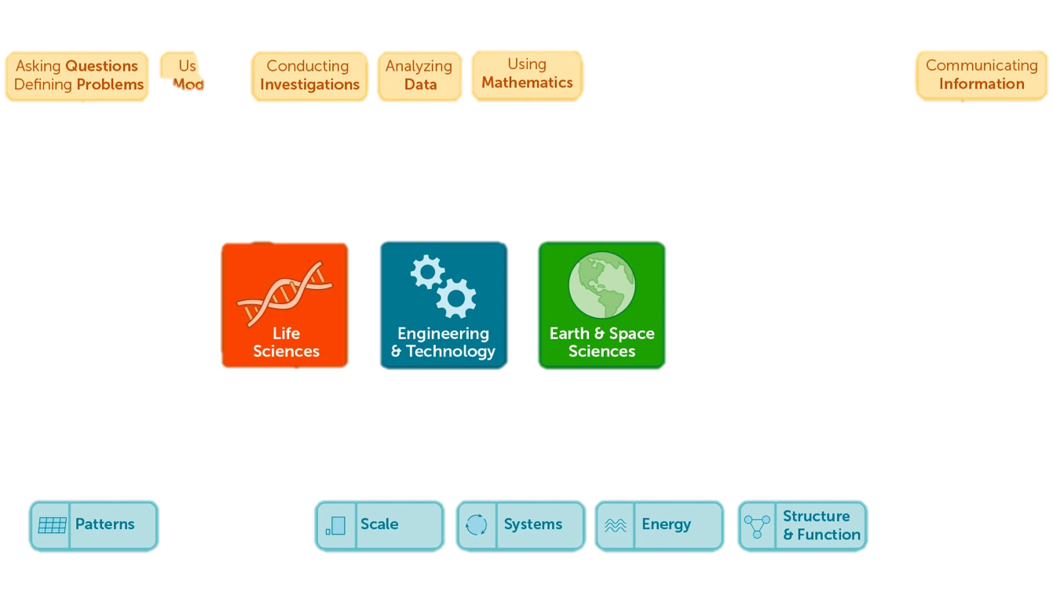
#1 - Micro:Polo– Open Networks/Adversarial Thinking & Ethics
Andrea.Burrows@UWYO.edu |Mike.Borowczak@UWYO.edu
@SciEdBurrows | @mborowczak

Slide 6
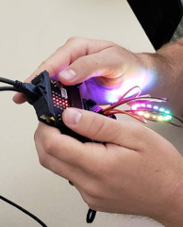
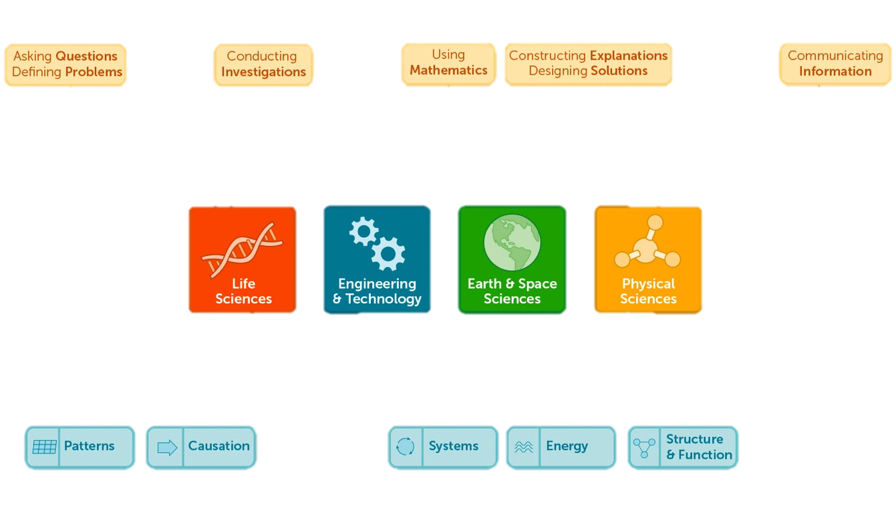
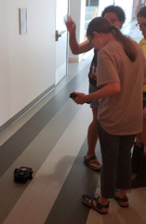
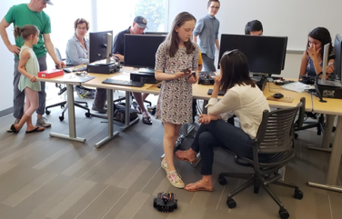
#2 - Micro:Bot:Wars– Cmd/Control & Cryptography / CIA-Triad
Andrea.Burrows@UWYO.edu |Mike.Borowczak@UWYO.edu
@SciEdBurrows | @mborowczak

Slide 7
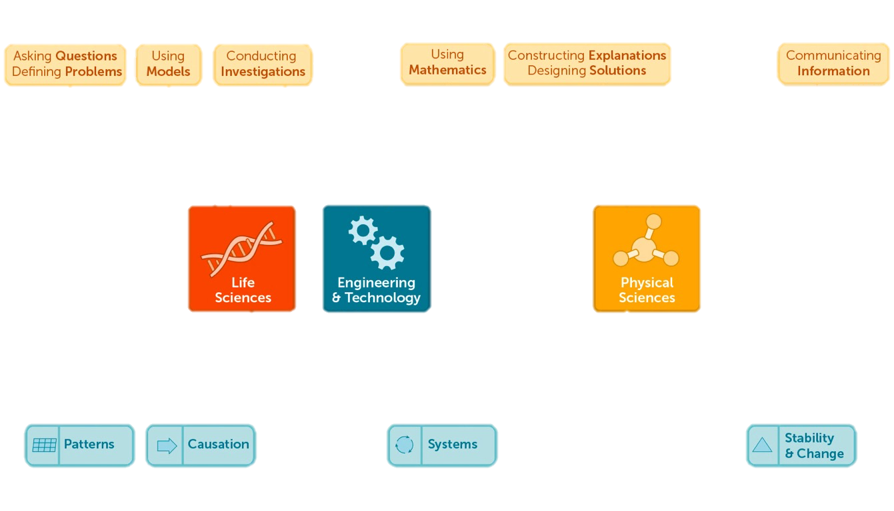
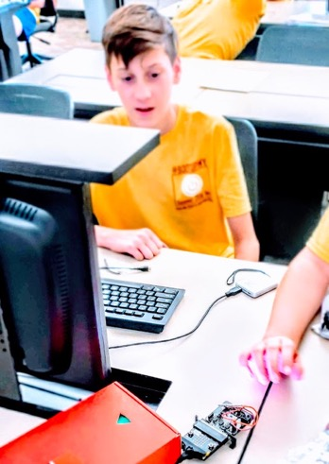
#3 - Lock:Bit - Spoofing an Intelligent Lock / Keep It Simple
Andrea.Burrows@UWYO.edu |Mike.Borowczak@UWYO.edu
@SciEdBurrows | @mborowczak

Slide 8
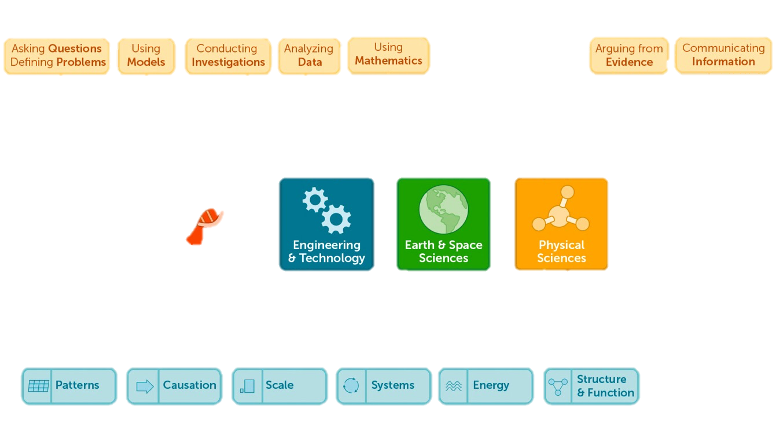
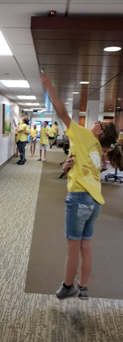
#4 - Micro:Fit:Bit- Forensics, Privacy & Data Mining
Andrea.Burrows@UWYO.edu |Mike.Borowczak@UWYO.edu
@SciEdBurrows | @mborowczak

Slide 9
Standards and More
Andrea.Burrows@UWYO.edu |Mike.Borowczak@UWYO.edu
@SciEdBurrows | @mborowczak
NGSS – Next Generation Science Standards
Nextgenscience.org
Common Core – Math and English Language Arts
corestandards.org/
ISTE – International Society for Technology Education
iste.org/standards/for-computer-science-educators
Active Inquiry Cyber Labs (open-access, tailor at will)
uwcedar.io/community/cowpokes

Slide 10
Andrea.Burrows@UWYO.edu |Mike.Borowczak@UWYO.edu
@SciEdBurrows | @mborowczak
Thank you!
uwyo.edu/SEED | uwyo.edu/CEDAR
Notes:
Active Inquiry Cyber Labs

Slide 11
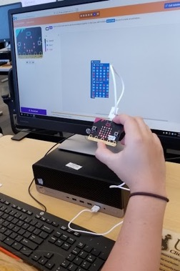
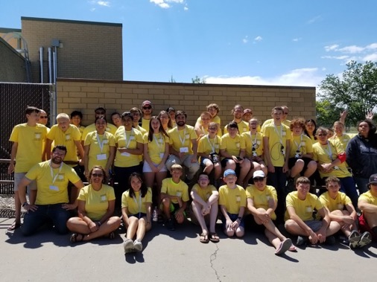
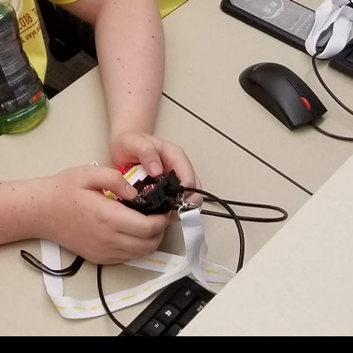
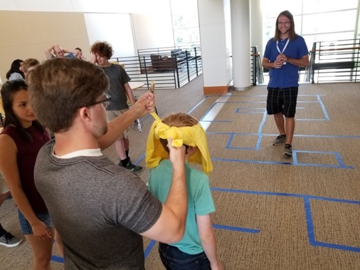
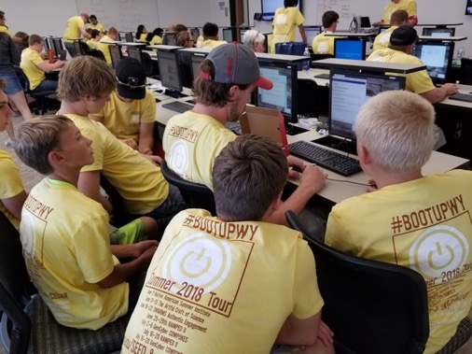
Participant Pictures – Summer 2018

